Slide 1
LionWeb:
Status +
Use cases
LangDev 2026
Meinte Boersma, Niko Stotz

Slide 2

Short introduction

Slide 3
Mission
Adopt language engineering
Reduce vendor lock-in
Mix and match components
Foster innovation and incremental improvements
To create an ecosystem of interoperable components for building language-oriented modeling tools on the web.

Slide 4
Reference Architecture
Clients
Editors
  Visual
  Projectional
B
C
F
A
G
G
1
D
Processors
  Model checker
  Importer
  Generator
2
C
F
D
E
E
Repository
Models
  Original
  Derived
A
Protocols (bulk + delta)
Contents (JSON)
B

Slide 5
Talks
  LangDev 2023 (slides, video)
  LangDev 2024 (slides, video)
  SEN Symposium 2024 (conference, slides)
  MODELS 2024 (conference)
  LangDev 2025 (slides)
  MBSE 2025 (slides, conference)
  MODELS 2026 — Industry Day (slides <== TODO)

Slide 6
Other talks about LionWeb @ LangDev’26
Title | Speaker | Affiliation
LionWeb in the Real World: Lessons from a Massive Legacy Migration Thursday 17:15 | Alessio Stalla | Strumenta
Reinvigorating TRUMPF laser programming with LionWeb Friday 8:30 | Niko Stotz, Johannes Tauber | F1RE, TRUMPF
Implementing MyFPL with LionWeb Friday 11:30 | Meinte Boersma | DSL Consultancy

Slide 7
Status

Slide 8
Progress
New core members
  Sergey Zverlov (F1RE)
Office hours (for outreach)
  Once a month (every second Friday) — successful!
Progress
  Released 2026.1 (as of now!)
    Main feature: Delta Protocol (specification)
  OpenAPI specification for Bulk API

Slide 9
Delta protocol
Released as part of 2026.1
Is seeing heavy use in production with a large customer²
  — Spec and implementations turned out to be a very good fit
Changes since last year:
  Command and event names more consistent
  Chunked messages
  Precisely-defined errors
Implementations available in: C#, TypeScript, JVM, and server

Slide 10
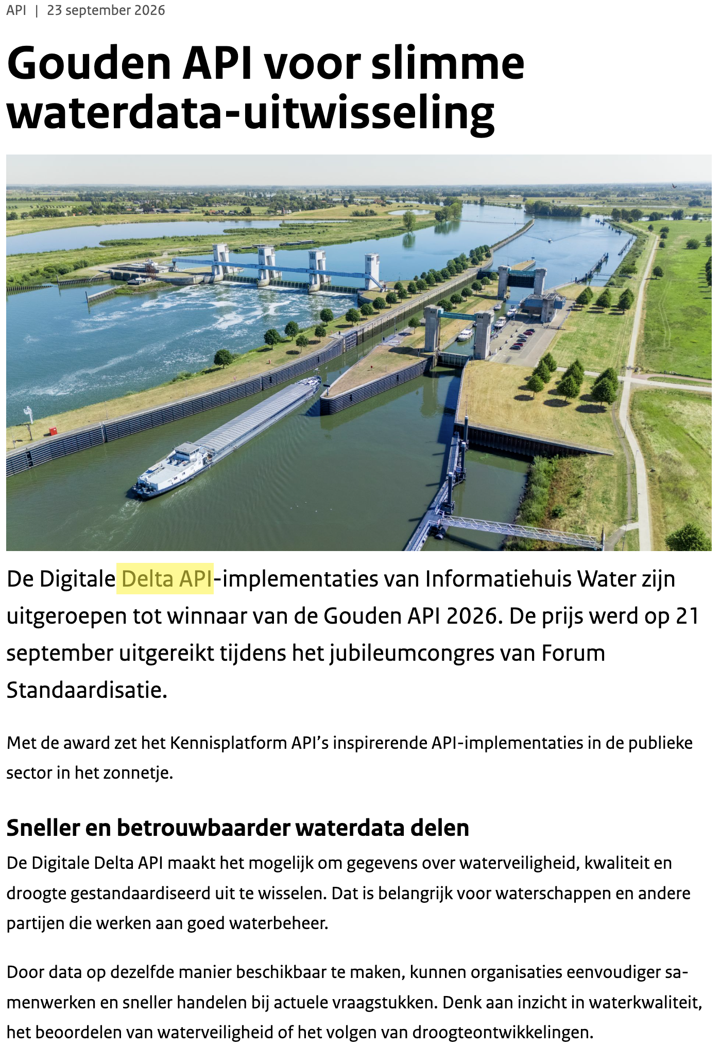
Award time!

Slide 11
Use cases

Slide 12
Overview
  Strumenta: legacy transformation of huge code bases
  TRUMPF: essential part of infrastructure
  LionWeb implementation of an MCP
  LionWeb as integration platform
  How to implement an LWB with LionWeb

Slide 13

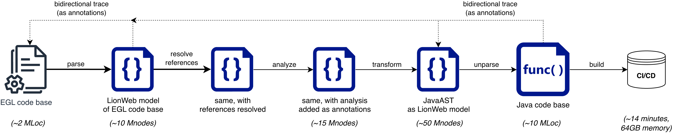
Strumenta
  Separate talk, today (Thursday) @ 17:15:
  LionWeb in the Real World: Lessons from a Massive Legacy Migration
  Use case: legacy transformation of huge code bases
  e.g. ~2 MLoC of IBM EGL code

Slide 14
Strumenta
  LionWeb-specific optimizations:
  Save each partition as a separate file
  in a custom Protobuf variant of the LionWeb serialization format
  Intermediate results are stored as annotations: avoids recomputation
  Cache things like “what are all (incl. inherited) features of this classifier?”
  Plenty of “old-fashioned Java optimizations” brought to lionweb-jvm
  Parallelize: parsing files, processing partitions

Slide 15

TRUMPF
Separate talk, tomorrow (Friday) @ 8:30:
Reinvigorating TRUMPF laser programming with LionWeb
Use case: a laser CAM system with its application data held as a LionWeb model that’s replicated across multiple components
Key takeaways:
  The project turned out to need most of LionWeb’s capabilities (Delta, Bulk, etc.)
  Delta protocol is used as a mechanism to sync a replicated model
  TRUMPF funded the LionWeb open source work
  — especially the C# and TypeScript implementations

Slide 16
LionWeb MCP
Atanas Marchev (F1RE) built a LionWeb MCP server:
  Exposes models in MPS as LionWeb repositories through MCP tools
  These MCP tools are LionWeb-specific,
  but aspecific to specific LionWeb languages.
  Examples:
      findNodeByName
      changePropertyValue
  Uses a LLM-powered chatbot to interact with the repositories
  Demoed: interrogate and manipulate RegelSpraak model in ALEF

Slide 17
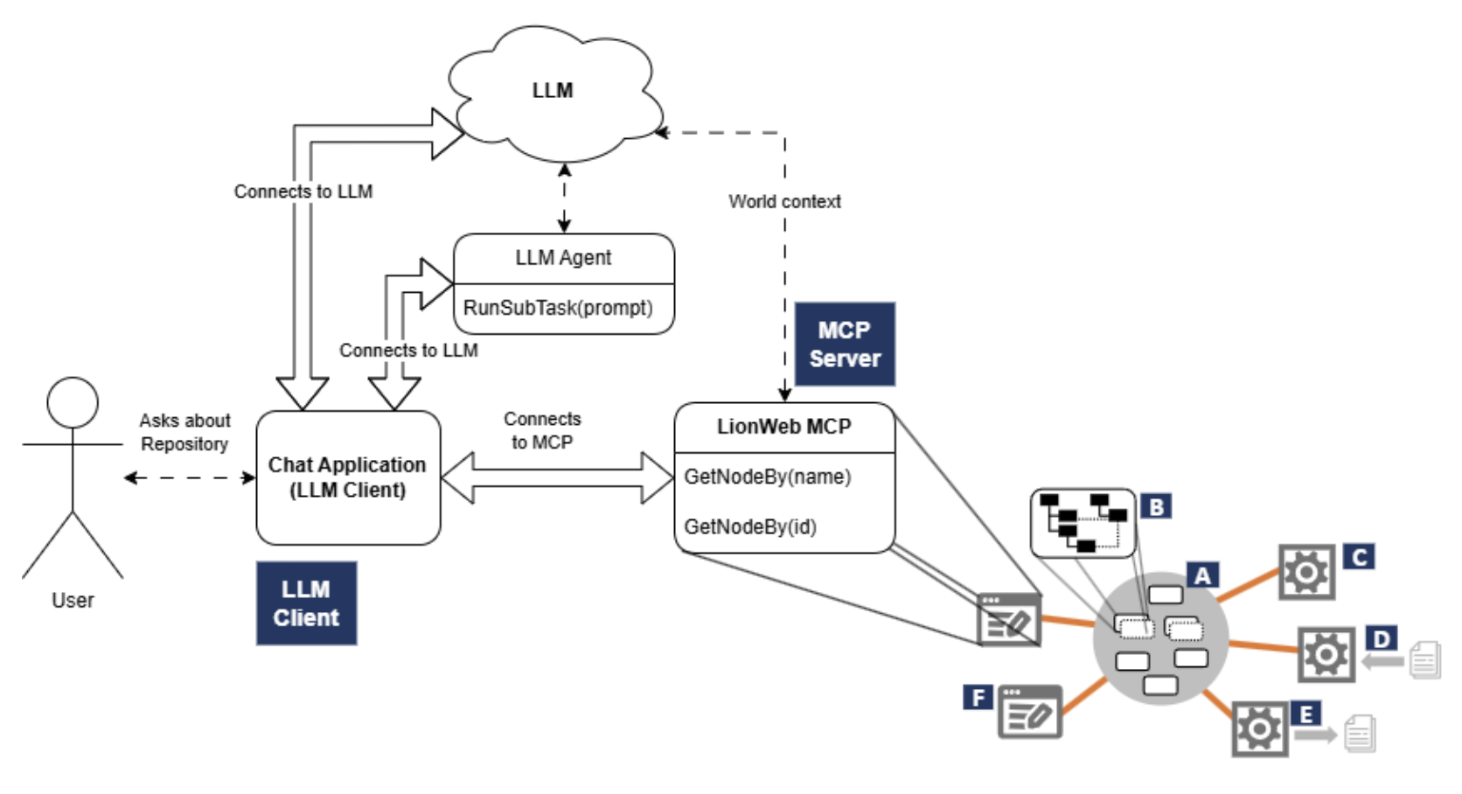
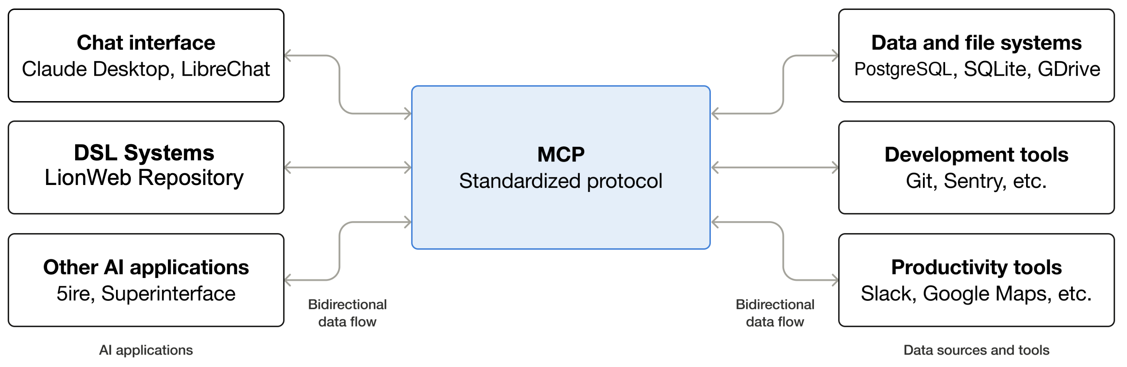
LionWeb MCP

Slide 18
LionWeb-driven integration platform
Niko?

Slide 19
LionWeb-driven LWB
Niko?

Slide 20
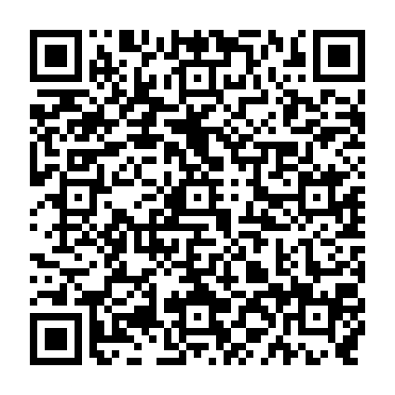
Team and Contact
Team
Meinte Boersma DSL Consultancy
Erkan Diken Belastingdienst
Norman Koester itemis (Modelix)
Sergej Koscejev Freelancer
Sascha Lisson itemis (Modelix)
Pedro Molina Metadev
Eugen Schindler Canon Production Printing
Alex Shatalin JetBrains (MPS)
Niko Stotz F1RE
Federico Tomassetti Strumenta
Markus Voelter Freelancer
Ulyana Tikhonova F1RE
Jos Warmer Freelancer (Freon)
Sergey Zverlov F1RE
Want to work with us: GitHub: Web:
info@lionweb.io https://github.com/LionWeb-io https://lionweb.io/
Slack to follow us, use, or implement LionWeb:
https://join.slack.com/t/lionweb/shared_invite/zt-2k1k5bsv7-EvC2IABIgSxWrqJNVOZ0HQ
Contact

